Slide 1
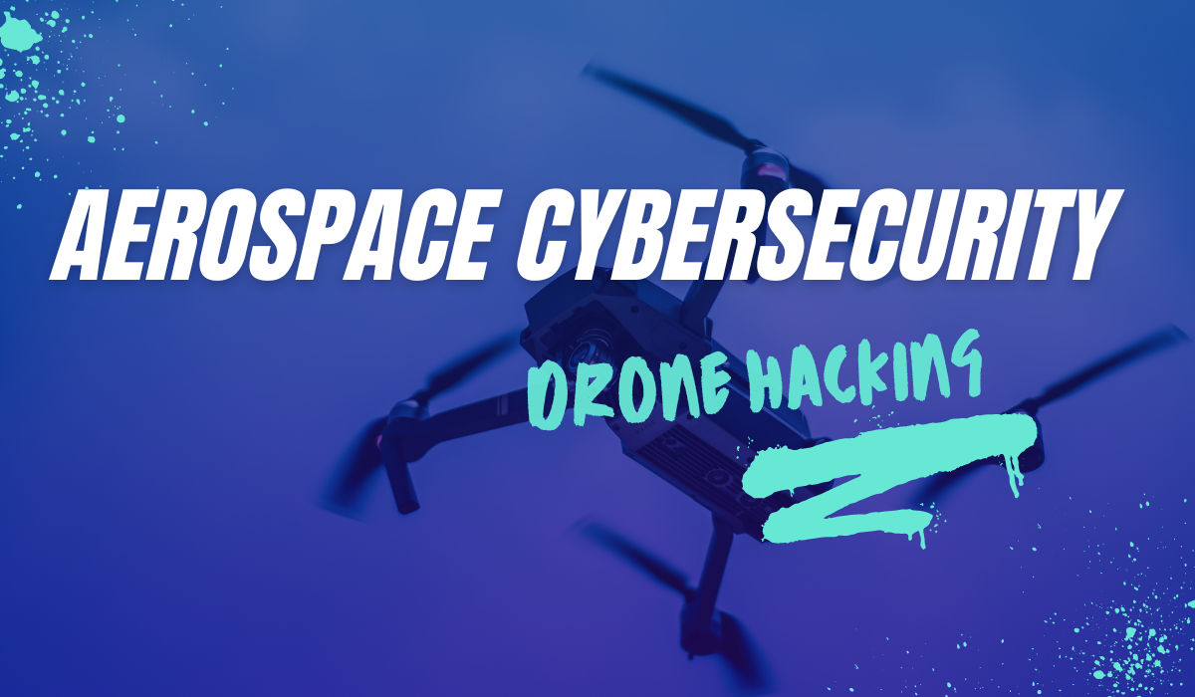
Angelina Tsuboi (G4LXY) x angelinatsuboi.com

Slide 2




ABOUT ME
DEVELOPER, AEROSPACE CYBERSECURITY,
RESEARCHER @ NASA
I build aerospace cybersecurity programs and multidisciplinary engineering projects to spearhead new technological endeavors and research. I have researched DJI RE and Digital Forensics alongside developing open-source drone programs.
angelinatsuboi.com | G4LXY.space

Slide 3

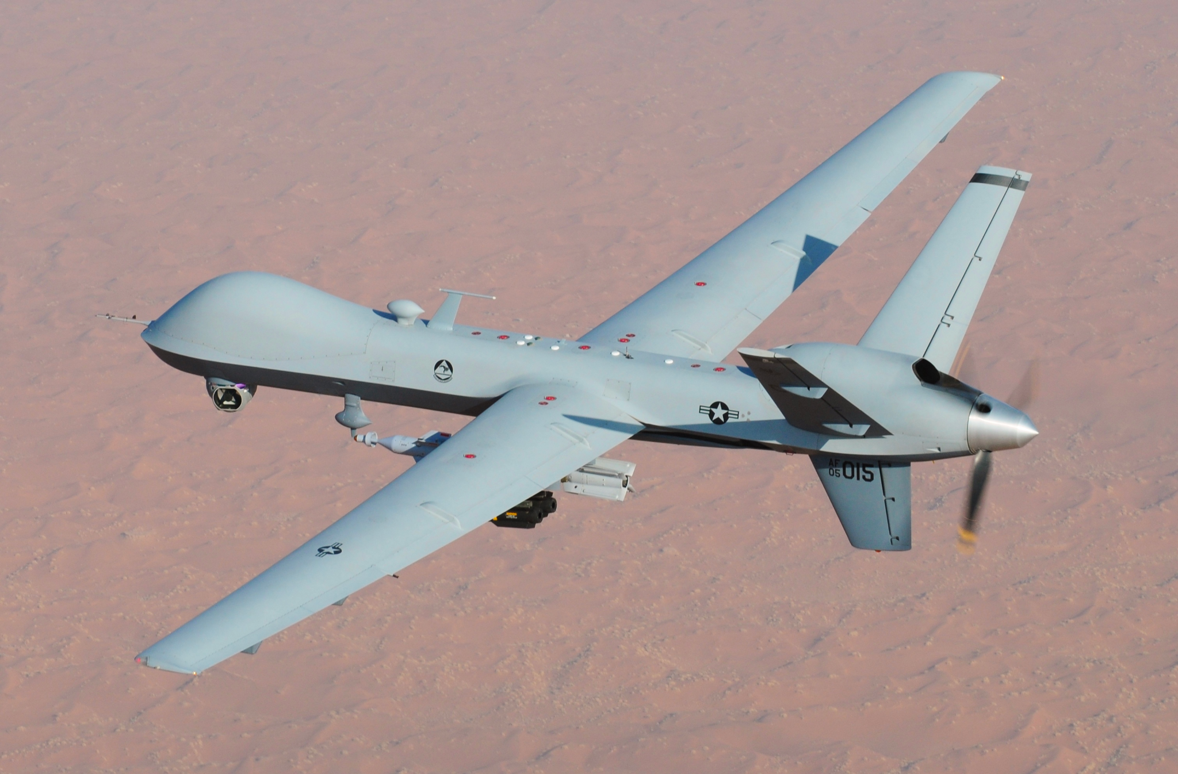
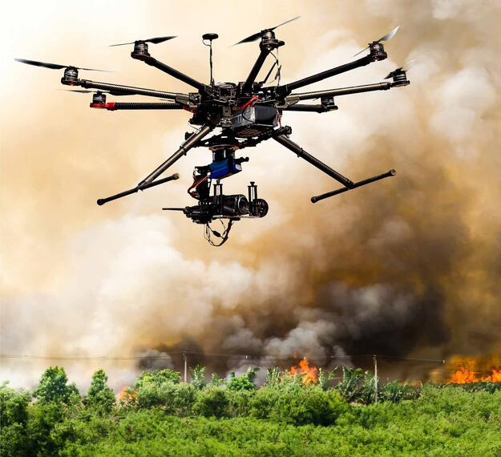
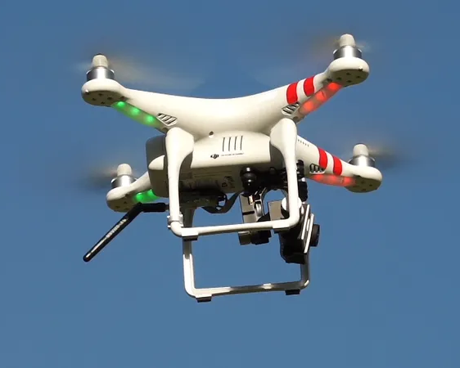
WHAT IS A UAV?
An Unmanned Aerial Vehicle (UAV) is an aircraft that does not carry a pilot onboard.
Compared to other aircraft, UAVs have a smaller form factor, are more precise, and cost-effective making them popular for use in commercial and consumer applications
Military UAVs
Mapping UAVs
Recreational UAVs

Slide 4


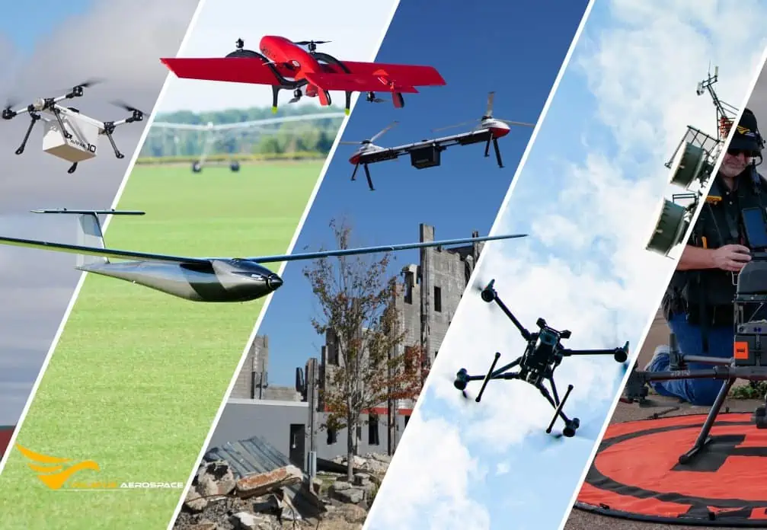
What are UAVs Used For?
Agriculture: Crop monitoring, precision agriculture, environmental analysis, etc
Aerial Photography Filmmaking and videography, real estate, and event coverage
Law Enforcement: Surveillance, crime scene forensics, and crowd control
Search and Rescue: Rescue missions, disaster response, and searching
Surveying and Mapping: Land surveying, cartography, and monitoring

Slide 5
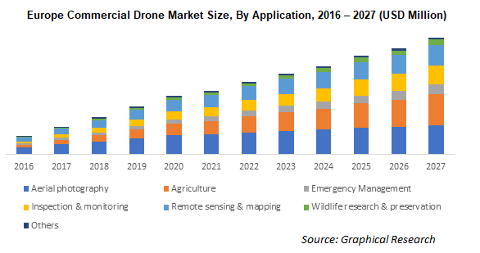
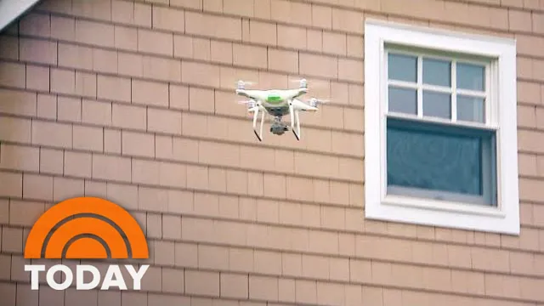
Rising Demand & Security Threats
The UAV drone market has shown significant growth over the years as they have been increasingly adopted for new applications and technologies.
However, this rising demand for UAV systems has also been met with an increase of UAV related crime. Common crime scenarios include: Contraband Drop offs:
Drones are typically used to drop off illegal payloads into unauthorized territory. Example includes drug delivery to prisons
Spying and Voyeurism:
Drones are used to snoop into people’s territory in order to capture footage
Electronic Warfare:
Drones are also used by military organizations to terrorize enemies via reconnaissance or direct bomb drops

Slide 6
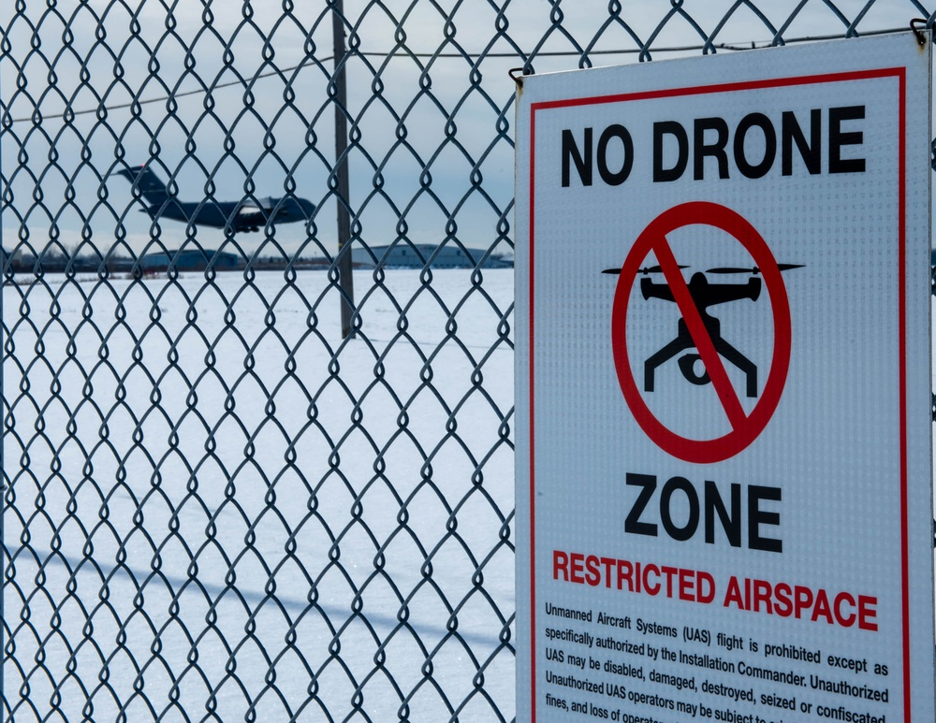
Safety & Rules and Laws
FAA UAV Safety Regulations:
Drones that weigh between 0.55 and 55 pounds (including payload) need to be registered with the FAA.
Remote Pilot Certification (Part 107) if you are operating a drone for commercial purposes
Drone operators must keep their drones within visual line of sight at all times during flight
Remote ID: registered drones require a remote ID which lets their position and telemetry be tracked
Airspace Limitations:
The FAA has established No-Fly Zones around certain critical infrastructure, events, and locations.
Drone operations within controlled airspace (Class B, C, D, and E) require FAA authorization

Slide 7


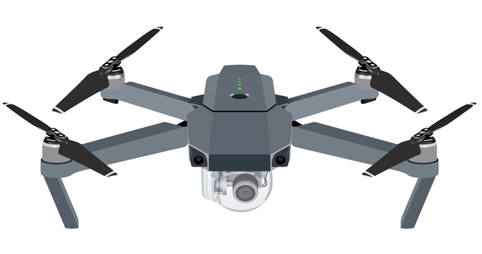
Attack Surface
Physical Device Attackers can physically compromise a drone by tampering with the drone components, disassembly, and introducing malware. Examples: tampering, theft, disassembly, or SD card access
Communication Interface Drones use wireless communication to create a link between the drone, mobile device, and remote controller. This communication can be intercepted, manipulated, or jammed. Examples: jamming, eavesdropping, spoofing, etc
Firmware & Software Software hosted on the drone pilot’s mobile device can introduce malware or be exploited granting unauthorized access to the drone’s control and data. Examples: data access, firmware attack, malware, etc

Slide 8




Reconnaissance
Enumeration
Gathering information about the target UAV using tools and research
Identifying features, services, and functionalities of a target UAV using available tools
Ie. OSINT, Network Reconnaissance, Information Leakage
Ie.Host Scanning, Sniffing Wireless Traffic, Firmware Analysis
4 Phase Attack Process
Discovery
Exploitation
Utilizing the information garnered during the enumeration phase to spot vulnerabilities
Probing vulnerabilities by using methods like privilege escalation and unauthorized access
Ie. Scanning ports, Web Application Testing, Flight Log Auditing
Ie. Bootloader Exploits, APK Sideloading, Attacking MAVLINK

Slide 9

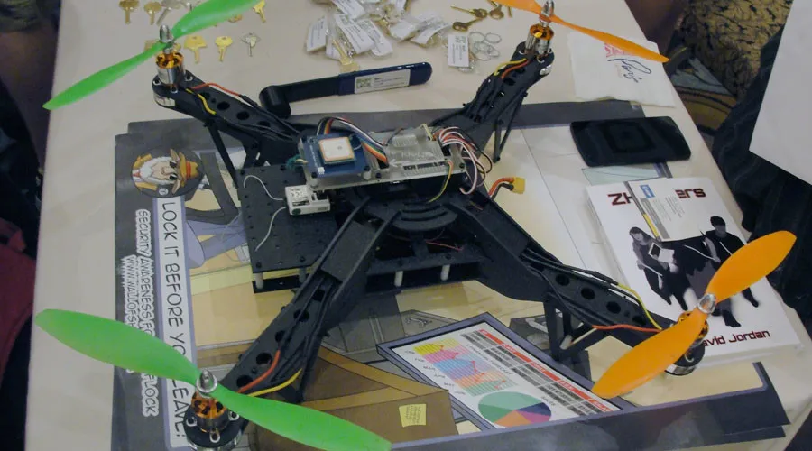
Vulnerability Overview: Physical Device
Tampering
Attackers can physically modify with the drone to install malicious hardware, insert rogue, components, or alter the firmware with malicious code
Theft or Device Interception
Stealing of either the drone of the device operating it can lead to access to unauthorized information and proprietary data
Physical Spoofing
Attacks can also use physical items to alter the navigation of the drone by tricking its sensory inputs. Examples include GPS interference and intentional object placement in the drone tracking

Slide 10
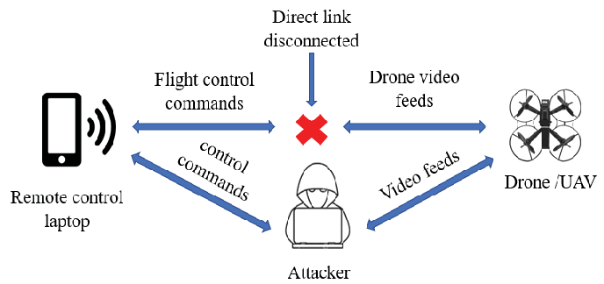
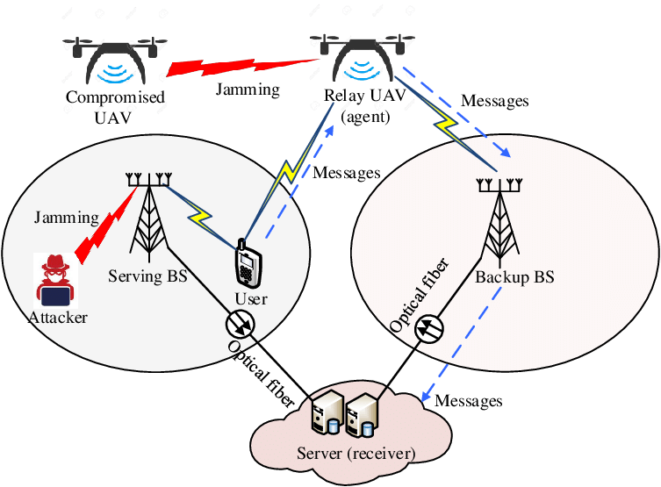
Vulnerability Overview: Communication
Control Signals
Attackers can physically modify with the drone to install malicious hardware, insert rogue, components, or alter the firmware with malicious code
Jamming or DoS Attacks
Stealing of either the drone of the device operating it can lead to access to unauthorized information and proprietary data
Man-in-the-Middle (MitM) Attacks
Attacks can also use physical items to alter the navigation of the drone by tricking its sensory inputs. Examples include GPS interference and intentional object placement in the drone track

Slide 11
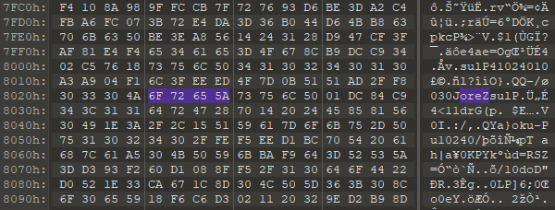
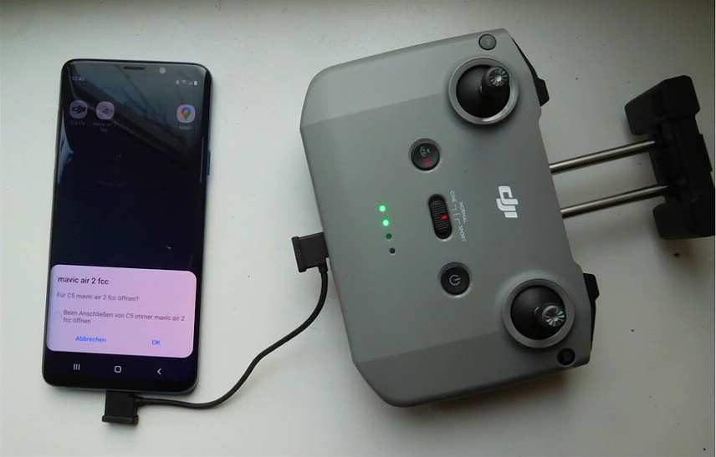
Vulnerability Overview: Software
Unlocking Geofencing
DJI software can be manipulated to unlock geofencing. Geofencing stops drones from entering prohibited airspace using GPS
Change NFZ & Altitude Limit
No Flight Zone can be extended and the altitude limit of a DJI drone can be altered by compromising the main controller settings
Signal Hacking
Flight modes such as CE and the FCC has lots of flight restrictions. Software can be adjusted in order to bypass the regulations during flight

Slide 12
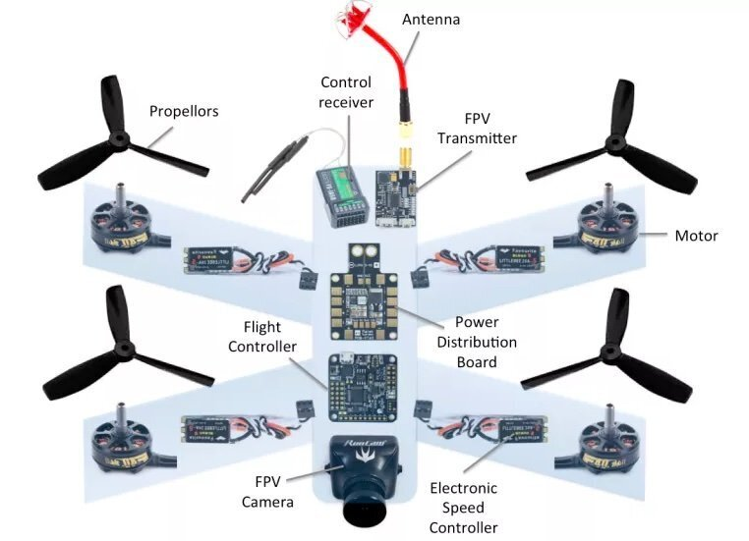
Drone Component Overview pt. 1
Propellers and Motors:
Allow for UAV control and flight
Power Distribution Board:
Distributes power to onboard components
Flight Controller:
Processes drone input and pilot commands
Electronic Speed Controllers:
Controls power sent to motors
Antenna and Transmitter:
Receives and transmits data to controller
Camera:
Takes videos and photos
Sensors:
GPS, Obstacle Avoidance, Altitude Detection, etc

Slide 13
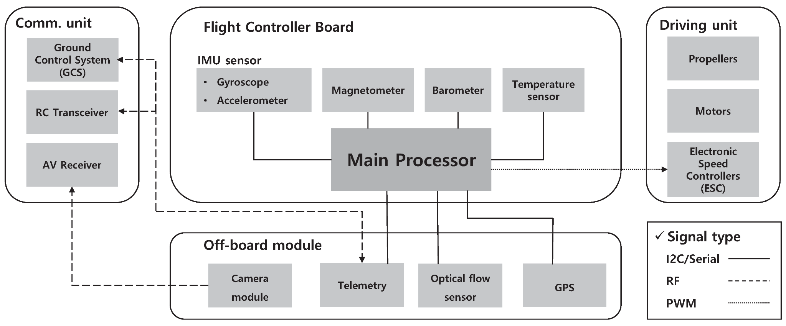
Drone Component Overview pt. 2
Flight Controller Board
Processes sensor information in order to issue commands to motors in order to respond to pilot inputs and maintain stable flight
Driving Unit
Controls flight behavior of drone ensuring stable and precise motion using commands provided by the flight controller
Off-board Module
Separate electronics module that is located outside the main electronic control unit (flight controller board). Includes sensors
Communications Unit
Electronic components for facilitating communication between different devices or systems
I2C / Serial - two wire interface (SDA and SCL) for simple IC communication
RF (radio frequency) - that uses radio waves to transmit data without physical connection
PWM (pulse width modulation) - transmitting data via width of pulses in a periodic signal

Slide 14


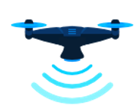

The Drone Stack
Drones and their associated devices are all endpoints in a network. As a result, drone networks are vulnerable to many traditional cyber-security attack vectors seen today.
Device/Application (192.168.1.30)
Android or iOS
Vendor Application
USB, Bluetooth or WiFi link
Controller
(192.168.1.1)
OpenWRT Linux or similar
Embedded or external device
2.4ghz – 5.8ghz antennas
Drone
(192.168.1.2)
OpenWRT Linux or similar
Internal and External Storage
2.4ghz – 5.8ghz antennas
Vendor Server (13.249.134.125)
Profile, flight logs, flight data, No-Fly-Zone codes
Optional: Purchases, linked accounts, country registration information

Slide 15
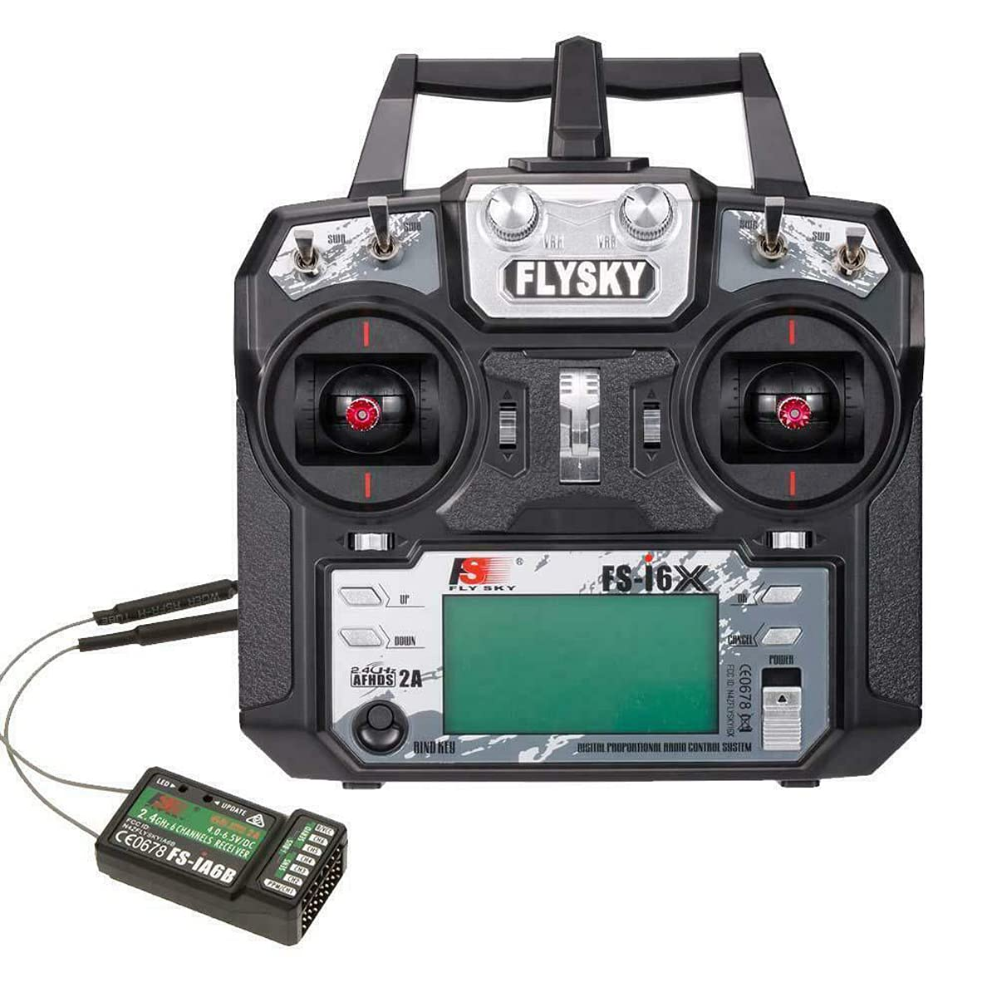
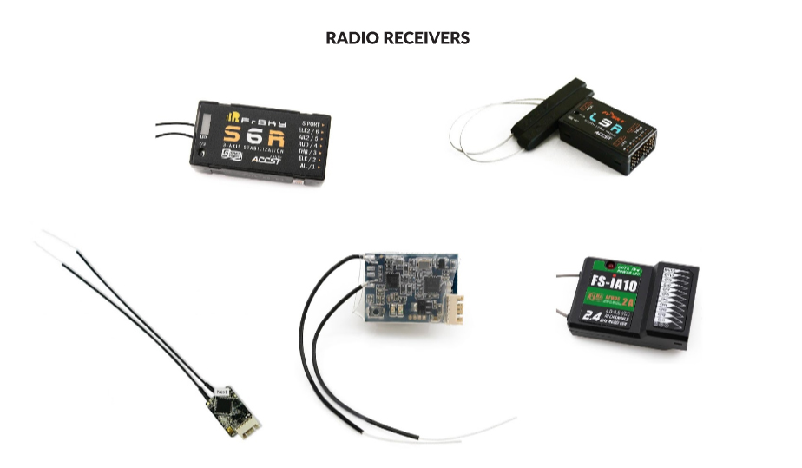
Drone Communication System
Transmitter:
Sends control signals and telemetry to a ground receiver (controller) or a station
Receiver:
Receives control signals and telemetry to execute instructions or data display purposes
Radio Transceiver:
Component that allows two-way communication between drone
And controller using modulation techniques. Operates on
frequency bands such as 2.4GHz or 5.8GHz
Mobile App and Device:
The device hosts the mobile app and serves as the interface for controlling the drone, accessing camera feeds, changing flight settings, and reviewing flight logs via Wi-Fi.

Slide 16
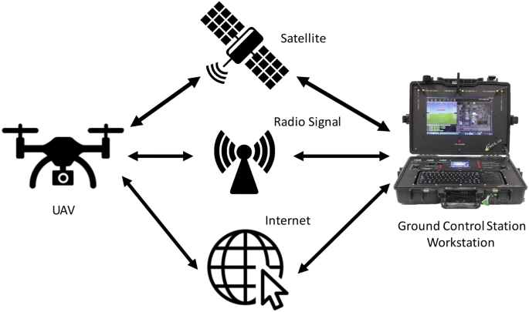
Drone Comm Data Links
Data links refers to channels through which data is transmitted through between drones and ground based stations or other devices.
RF (Radio Frequency):
Includes long-range capabilities and resists interference using frequency hopping. Operates on the 2.4GHz frequency and includes many channels for communications
Wi-Fi:
Usually operates on the 2.4GHz or 5GHz bands and provides high-speed, reliable connection. It is often used to transmit video and telemetry data. However, it is susceptible to interference and its range is shorter

Slide 17


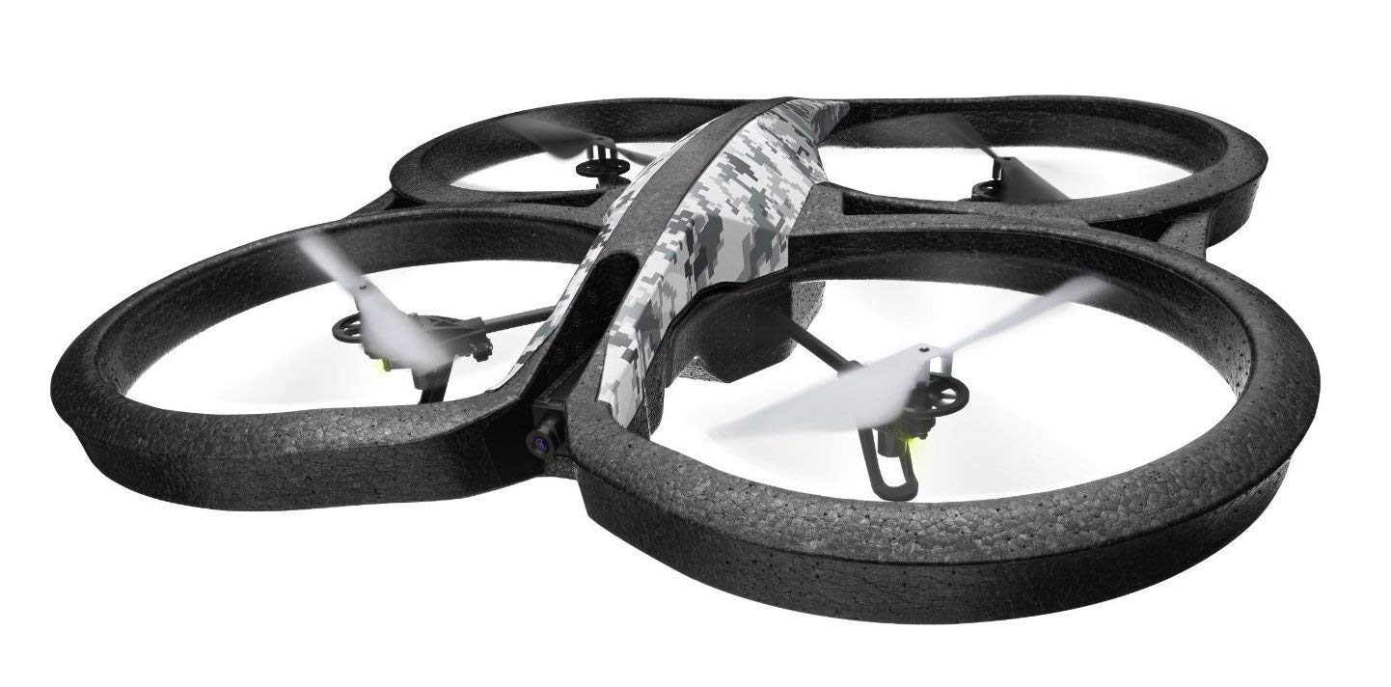
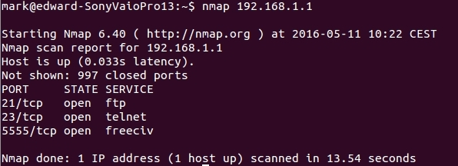
Lab 1: Drone Port Exploit
Parrot AR Drone 2.0

Slide 18
Procedure Overview
Reconnaissance:
Auditing and Researching the Parrot Drone to Find Possible Vulnerabilities
2. Port Scanning:
Use nmap to scan for open ports on the drone
3. Access Drone Media:
Using FTP to connect to the drone and access media
4. TCP Shutdown:
Using TCP to exploit the drone by executing commands
5. Communication Analysis:
Analyze the flight sequence using Wireshark

Slide 19

Tools Overview
nmap:
Free and open source network scanner. Can be used to find open networks on
drones that may be receiving or sending data
FTP command:
File Transfer Protocol (used to transfer files from system to system). Command is used to download media from drone
telnet command:
Telnet protocol (part of the TCP/IP protocol suite) to connect to remote computer. In this case, it is used to communicate and send commands to the target drone
ffplay command:
Simple and portable media player. We can use this command to convert drone packets into video.

Slide 20
Simulated CTF on Github
Visit this GitHub Repository:
https://github.com/ANG13T/drone-hacking-workshop Download the Github repository via Terminal:
git install https://github.com/ANG13T/drone-hacking-workshop.git
OR
Download the Github repository manually:
Click Code Button > Download ZIP > Uncompress ZIP

Slide 21
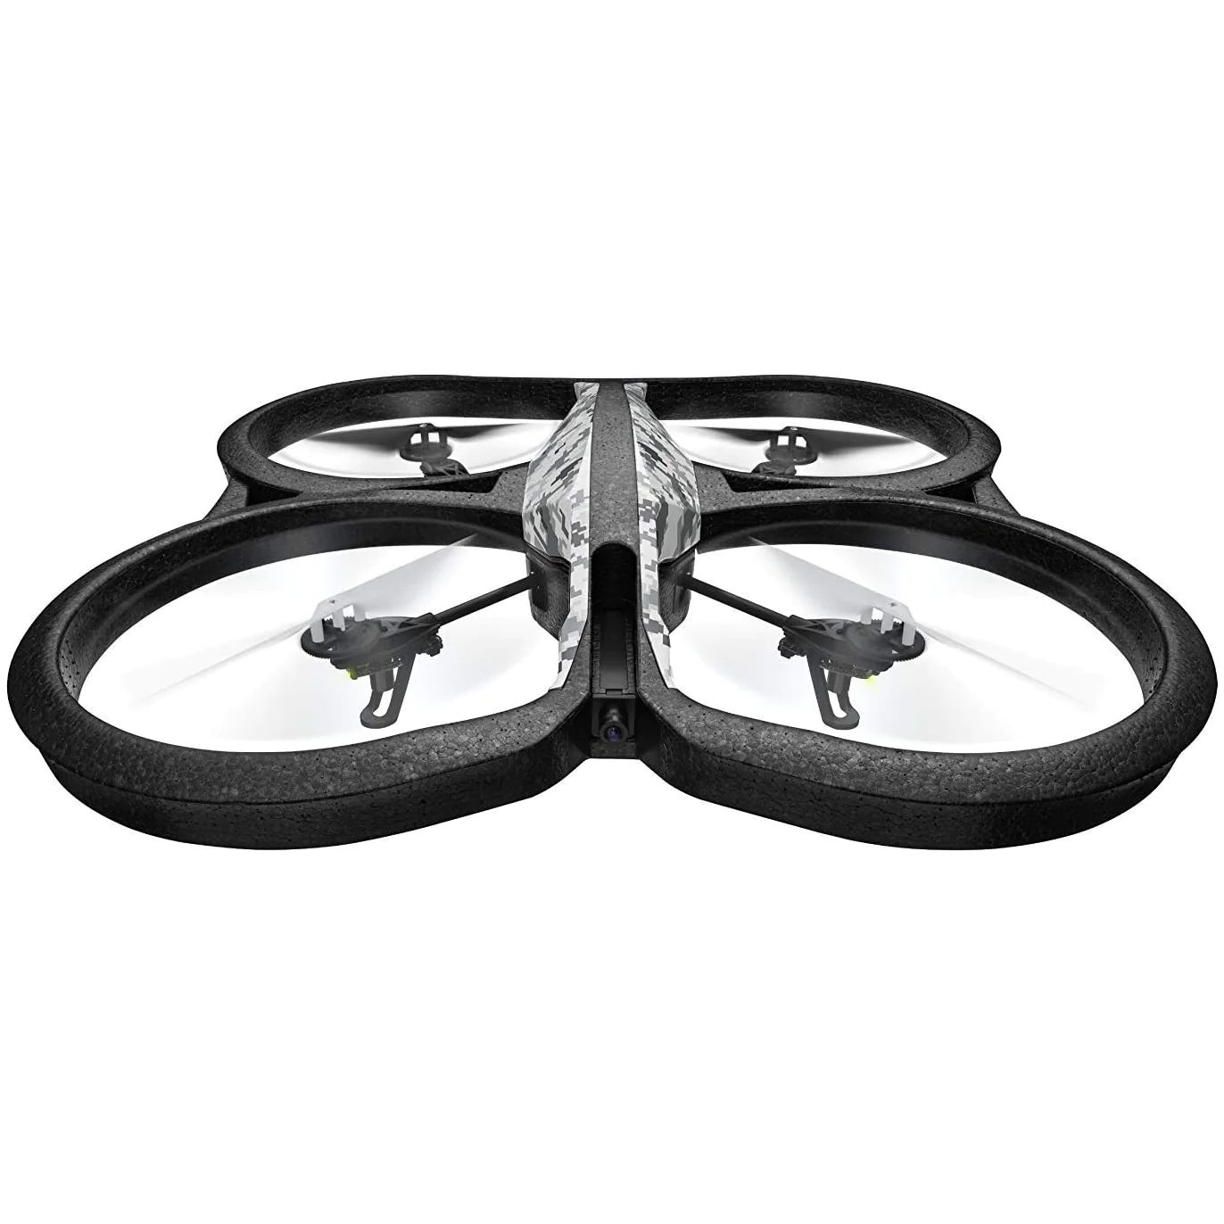
Step 1: Parrot Drone Reconnaissance
The Parrot AR.Drone 2.0 is a remote controlled quadcopter from the French company Parrot SA. The connection to the drone is established using its wireless router which consists of wireless 802.11 chipset.
Default IP to Access Admin Interface
192.168.1.1
Other Info:
Linux operating system on 2.6.32
1 GB of RAM 1GHz 32-bit ARM cortex A8 processor
Can be controlled via mobile device
OSINT methods:
Google
Wayback Machine
Social Media

Slide 22
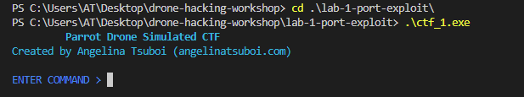
Running the Program
To start the program, follow the steps below:
cd lab-1-port-exploit
./ctf_1.exe

Slide 23
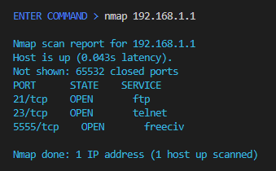
Step 2: Port Scanning with nmap
Use nmap to scan for open ports on the drone using the IP address
Reveals three open ports:
FTP 21
Telnet 23
Video 5555

Slide 24
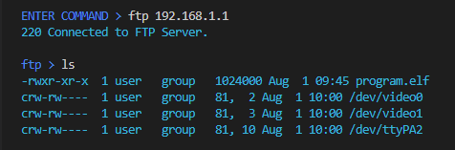
Step 3: Media Access with FTP
Use ftp to view available files and device files on drone
Reveals the following:
program.elf: binary file for drone functionality
/dev/video0: interface to the drone's camera hardware
/dev/video1: interface to the drone's camera hardware
/dev/ttyPA2: serial communication port on the drone

Slide 25
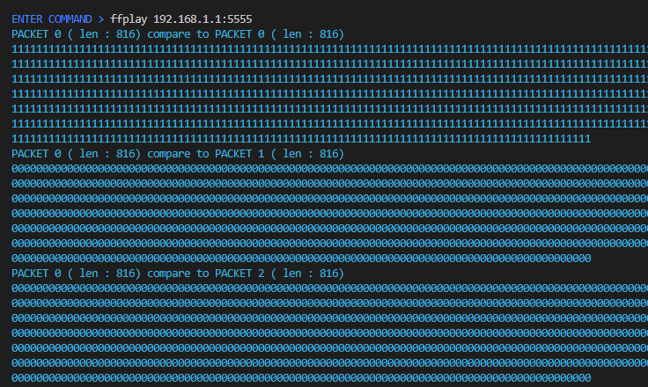
Step 4: Intercept Drone Video
Use ffplay on the 5555 port of the drone IP address to intercept drone footage
Drone footage is retrieved as packets and can be viewed as a video

Slide 26
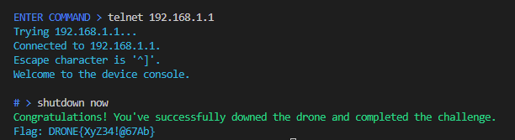
Step 5: Forced Shutdown with TCP
Use telnet to connect to drone and get root access
Cause the drone to dysfunction by issuing shutdown now

Slide 27
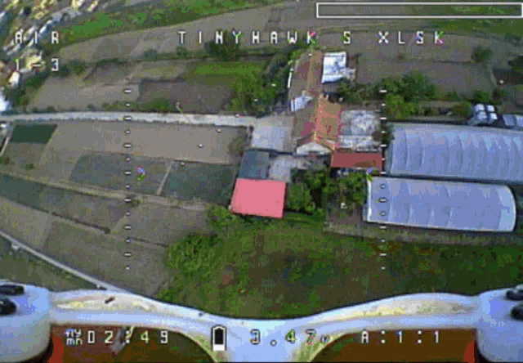
DRONE{XyZ34!@67Ab}

Slide 28
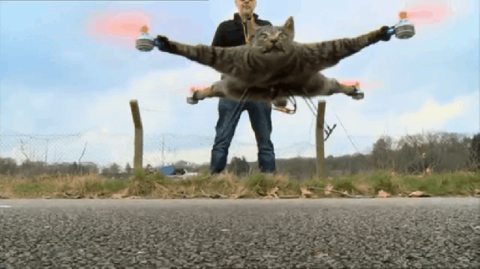
Let’s Take a Break!

Slide 29
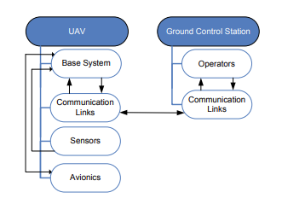
Ground Station Overview
UAV ground stations are used to control and monitor drone flight operations. However they contain the following vulnerabilities:
Unauthorized Access: Hackers can access control systems on the ground
Malware Exploitation: Attackers can compromise station functionality by uppading malware
Data Interception: Station communication can be compromised via eavesdropping
Network Vulnerabilities: Ground stations are vulnerable to attacks such as unauthorized access, MITM, or DoS

Slide 30
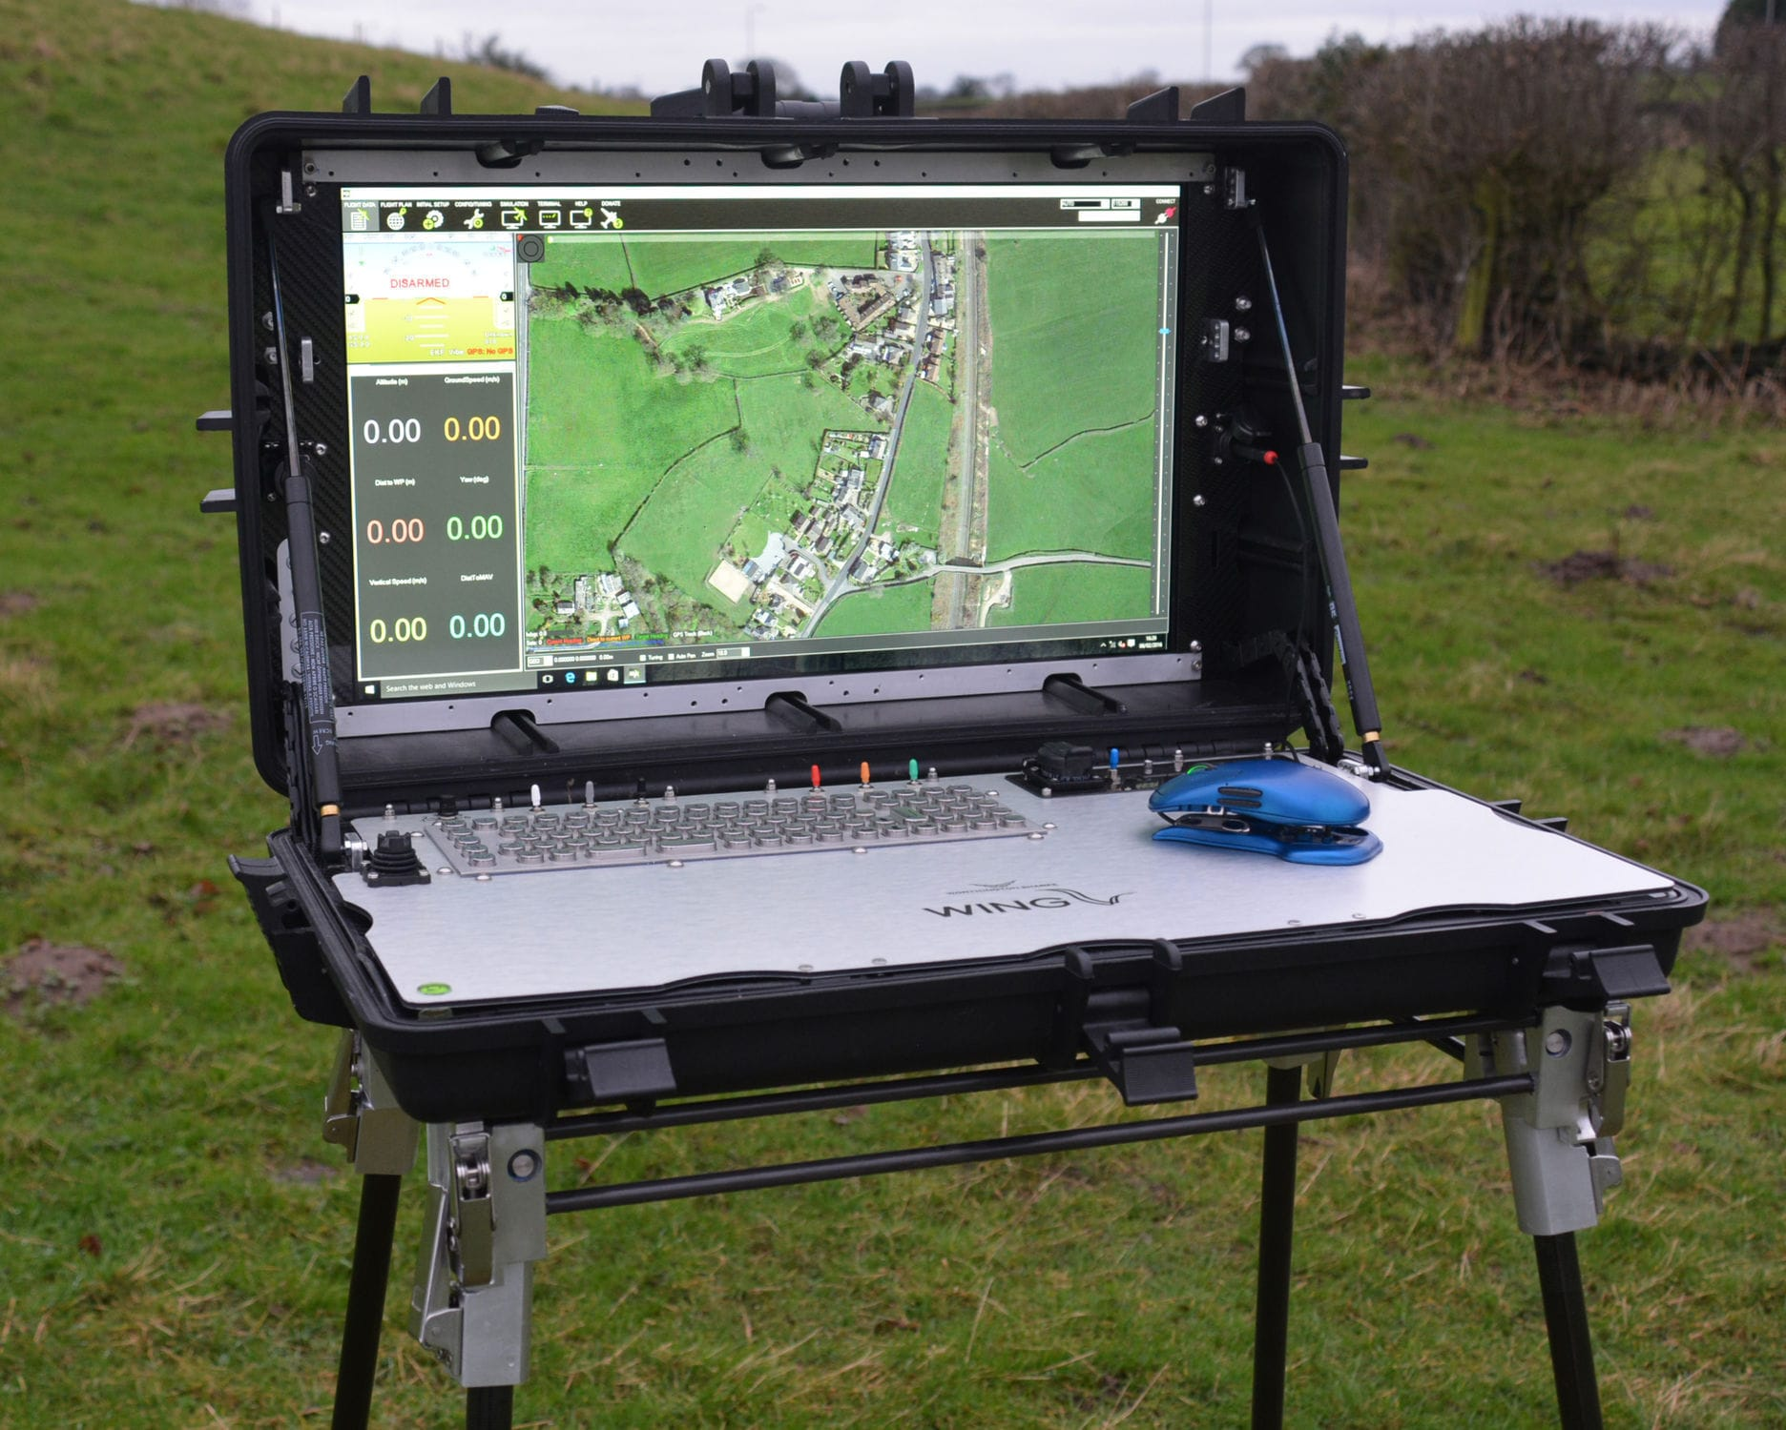
Ground Station OS Vulnerabilities
Operating systems on ground stations contain a number of vulnerabilities such as insecure credentials and missing patches
Windows: Microsoft Baseline Security Analyzer (MBSA): tool to identify missing security updates
Linux: Lynis: An open source security auditing tool for systems based on UNIX
Android: Android Debug Bridge (ADB): command-line tool to communicate with an Android device.

Slide 31

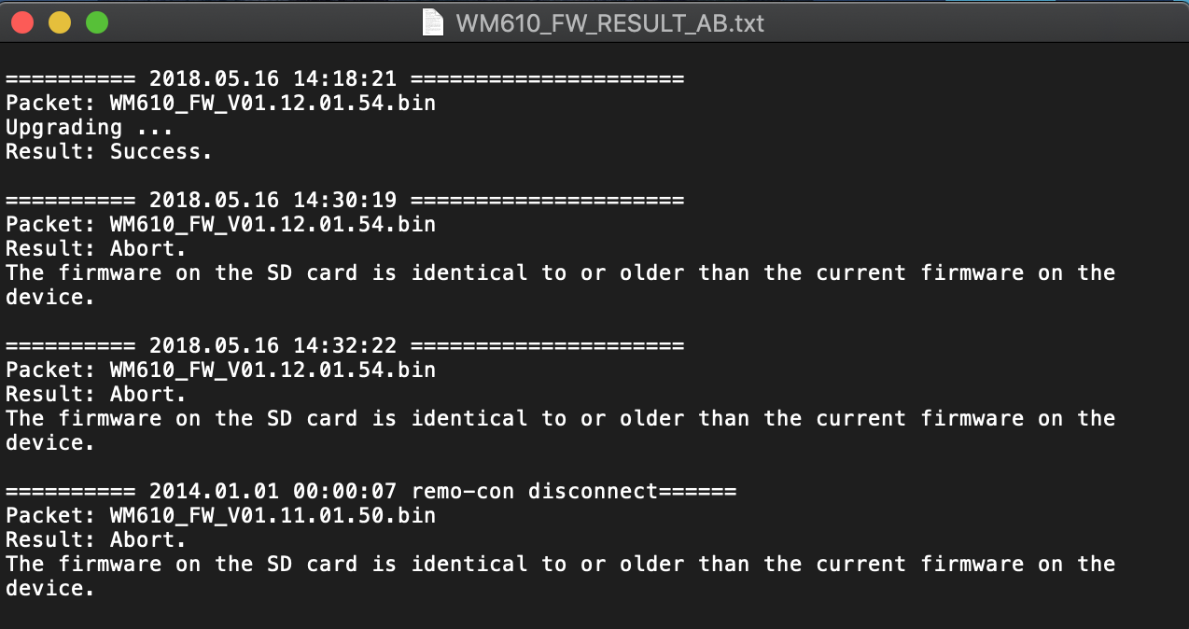
Mobile APK and Firmware Analysis
Mobile APKs:
APK files are application packages for drone-related mobile packages. They can be audited to find vulnerabilities and improper settings
Firmware:
Drone firmware and binaries can be inspected to spot hard coded secrets and vulnerabilities within drone functionality

Slide 32
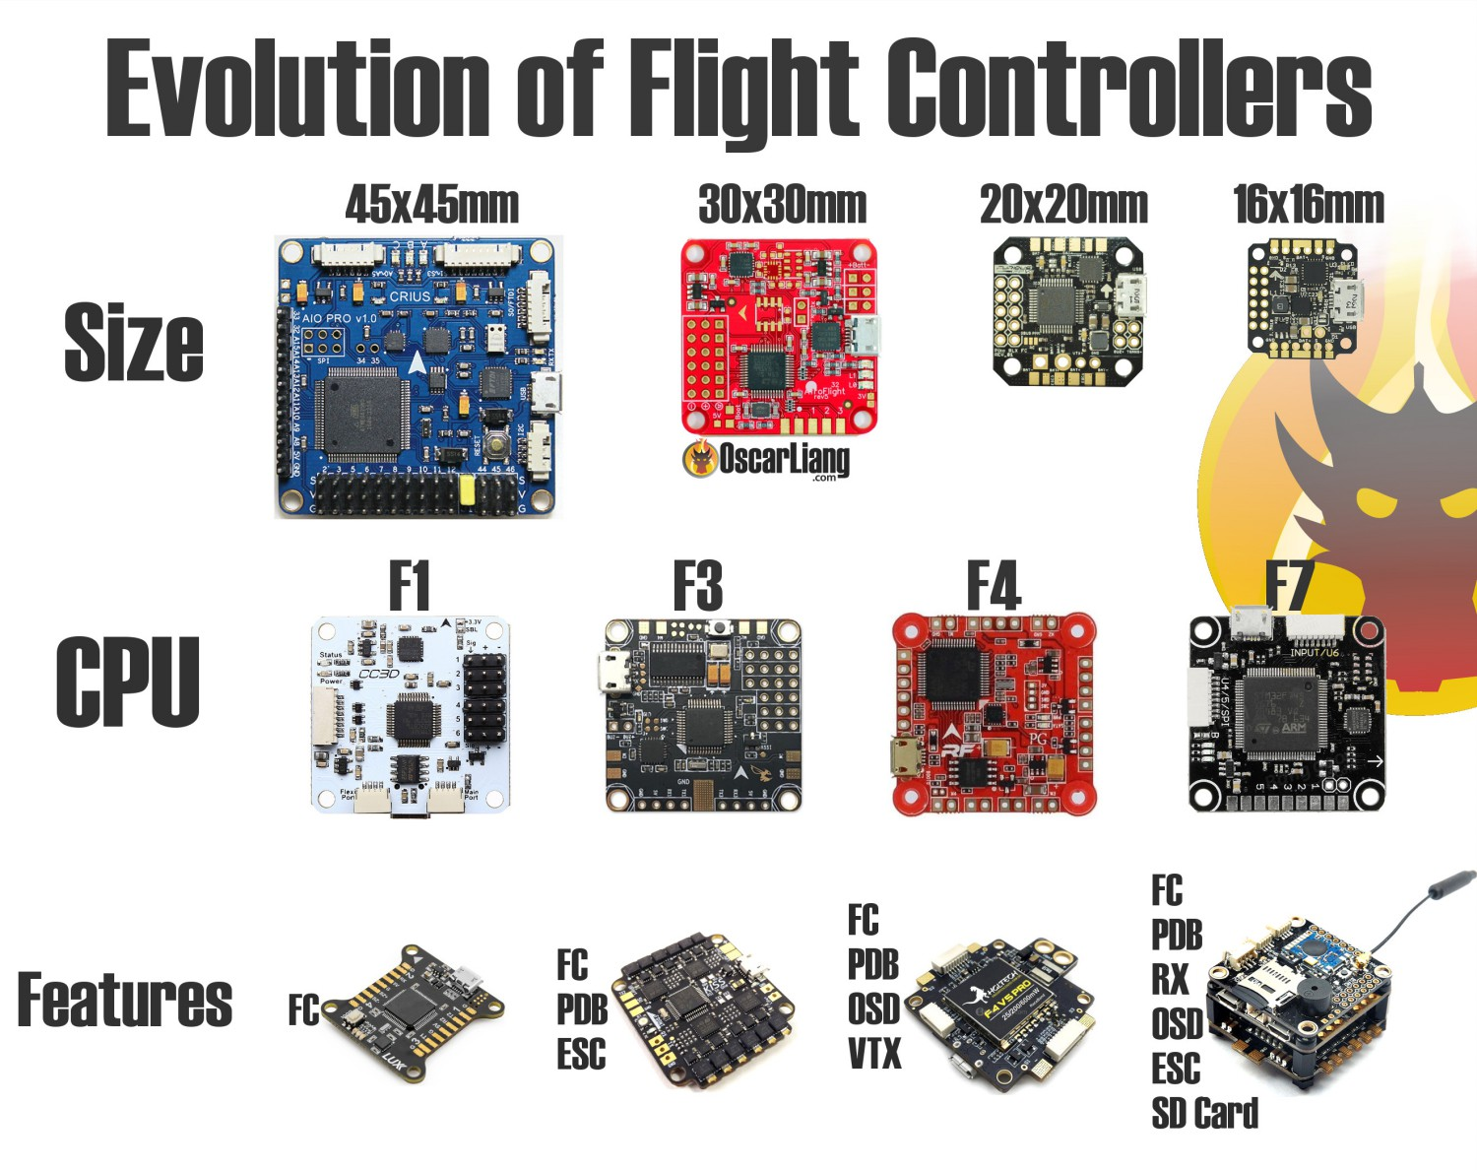
UART Analysis
UART (Universal Asynchronous Receiver-Transmitter) is used by hardware systems on the drone to transmit data
You can exploit the interface on the flight controller to access to system-level information

Slide 33

Drone and Mobile App Communication
Drone
GPS
Device/Application
5.8ghz video link
Approximate Location (5-10km)
Hardware Information (serial #s)
Mobile/Controller GPS Location
Drone GPS Location
Flight data (optional)
NFZ codes
Profile Information / Username
2.4ghz control link
Vendor Server
Controller
Internet: 4G/LTE

Slide 34
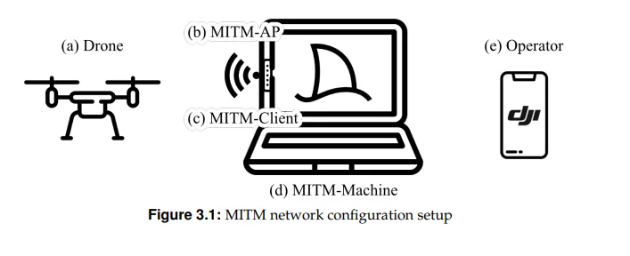
Communication Packet Analysis
DJI device software and hardware work together to create a communication link between the drone and controller / app.
Communication between the mobile app and drone can be intercepted using software such as Wireshark.

Slide 35
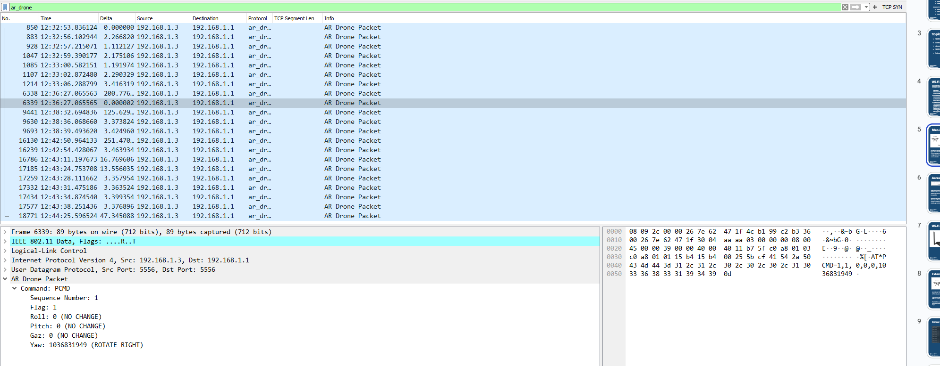
Lab 2: Drone Comm. Hacking

Slide 36

Tool Overview: Wireshark
Free and open source packet analyzer. We can use Wireshark to interpret communication between the drone and controller.
Wireshark also includes display filters which can be inputted to find packets based on protocol, packet type, and other categories

Slide 37
Step 1: Download PCAP File
Visit this GitHub Repository:
https://github.com/ANG13T/drone-hacking-workshop
Download Parrot_Drone_Sample_Capture.cap file

Slide 38
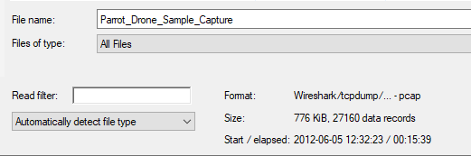
Step 2: Open Wireshark and PCAP File
Open Wireshark
Click File > Open
Select the Downloaded PCAP File

Slide 39
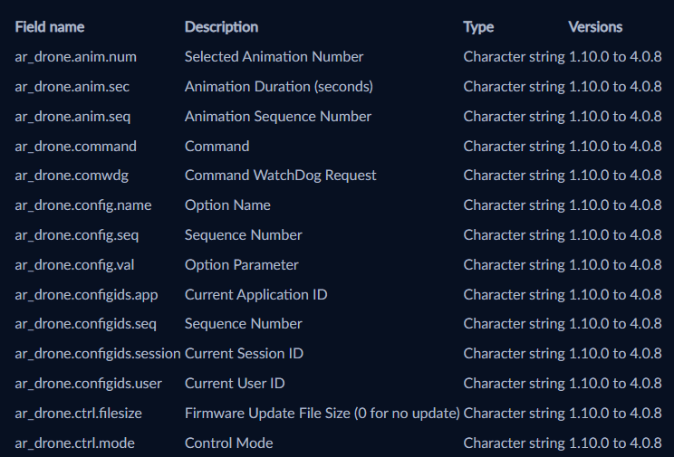
Wireshark Drone Display Filter
Network Protocols: Categories for network packets. They can be filtered and contain information about the packet
Parrot Drone Protocol:
Wireshark supports the AR Parrot Drone network packet filter allowing us to derive drone related data from packets

Slide 40
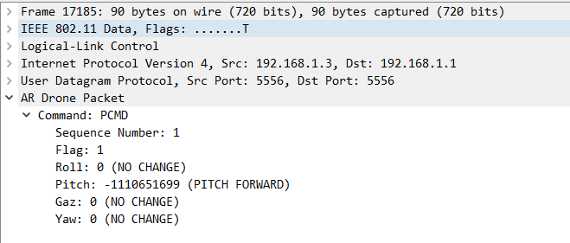
Step 3: Input “ar_drone” Filter
Input “ar_drone” in the display filter input field
Click Enter
Click on a Packet and Expand “AR Drone Packet”

Slide 41
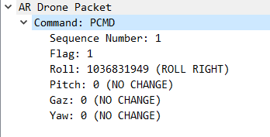
Drone Packet Information
UDP packet from port 5556 to port 5556
Has two commands: a PCMD_MAG and a REF
PCMD_MAG sets the velocity of the drone in each direction
REF is used to issue high level commands like 'take off', 'emergency stop/reset' or 'land'
Telemetry such as altitude, orientation, and velocity can be extracted

Slide 42

Countermeasures and Defense
Communication Interception:
Enabling proper encryption using third party software
Install anti-virus and a VPN to establish a secure connection
Jamming and Spoofing:
Switch your drone flying pattern to avoid being an easy target
Fly in an area with a few obstacles where the drone is in line-of-sight
Malware and Firmware:
Choose a drone from a credible manufacturer
Protect your ground station with anti-virus software
Physical Damage or Tampering:
Check for tamper evidence by looking for scrapes and rogue components

Slide 43
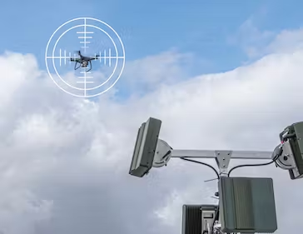
Drone Detection
Detecting drones is important to analyze drone-related crimes and ensure the safety of airspace
RF Analysis: Using radio frequencies to pinpoint drones and operators using triangulation
Drone Radar: Specially tuned radar systems can use radio energy to determine the location of drones
Detection Cameras: Thermal or visual cameras can be leveraged to detect drones using infrared and thermal imaging
DroneID: Identification protocol used by drones to transmit location of drone and operator

Slide 44
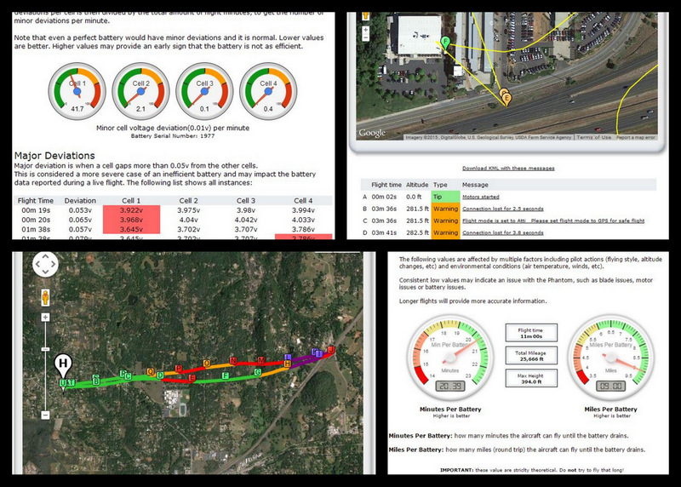
Drone Tracking & Data Mapping
Digital forensics can be used for drone tracking and mapping. Post-flight data can be extracted from compromised drones to reveal information such as:
GPS Coordinates of FLight
Flight Timestamps
Altitude
Velocity
Voltage Measurements
Much More!

Slide 45
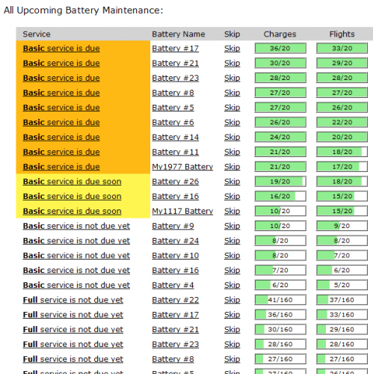
Flight Records Overview
Files that can be extracted from drones to conduct digital forensics are as follows:
RF Analysis: Using radio frequencies to pinpoint drones and operators using triangulation
Drone Radar: Specially tuned radar systems can use radio energy to determine the location of drones
Detection Cameras: Thermal or visual cameras can be leveraged to detect drones using infrared and thermal imaging
DroneID: Identification protocol used by drones to transmit location of drone and operator

Slide 46
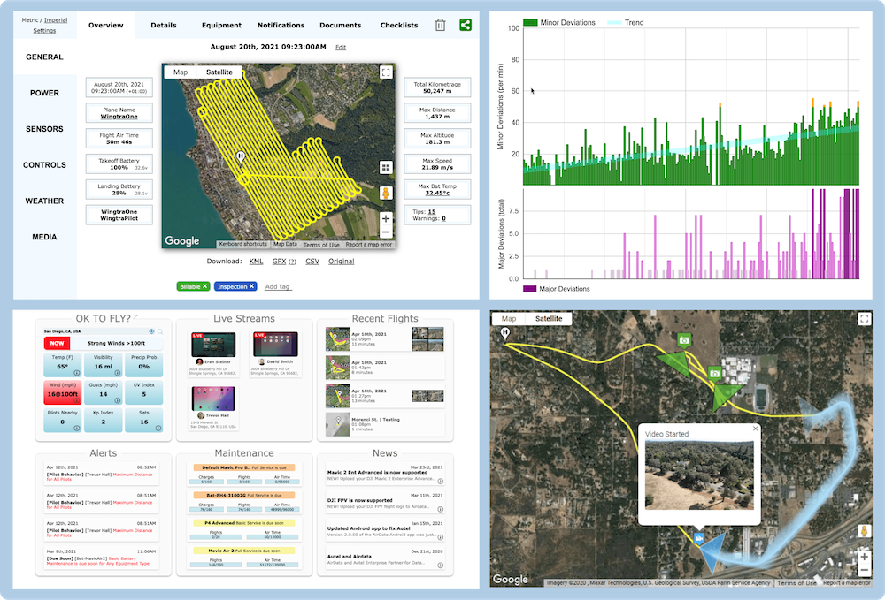
Lab 3: Digital Forensics Investigation

Slide 47
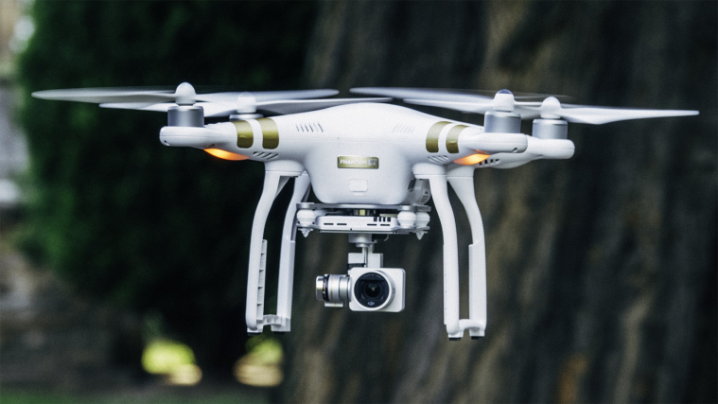
Crime Scenario
Your investigation team found a DJI Phantom 3 that was caught dropping off some contraband and crashed into the ground. The team was able to extract the SD card from the drone containing files
MISSON: make a case report containing information about the crime

Slide 48
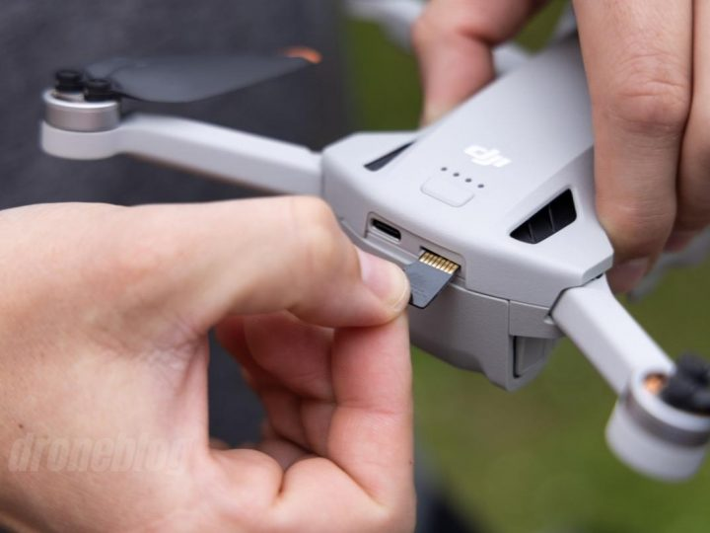
Files in SD Card
Flight Logs: Encrypted TXT files of the drone’s flight path
CSV Files: Comma-separated Values file format containing data about the drone telemetry and flight
Photos: Pictures the drone has taken during its flight

Slide 49
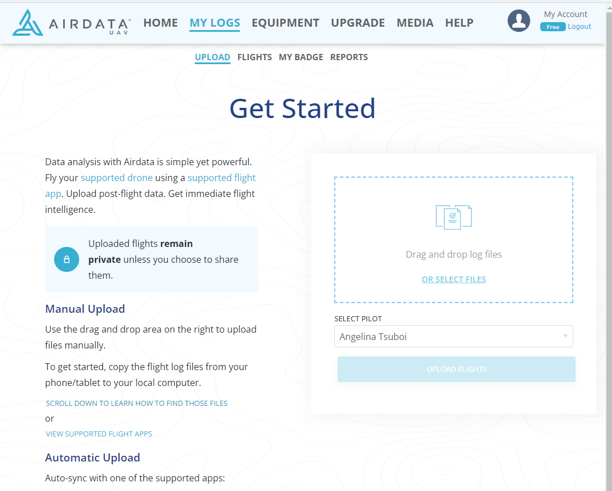
Step 1: Flight Log Analysis
Visit GitHub Repository:
https://github.com/ANG13T/drone-hacking-workshop
Locate the flightrecord.txt file inside lab-3-forensics folder
Go to Airdata Flight Logger Upload
Drop the flightrecord.txt file

Slide 50
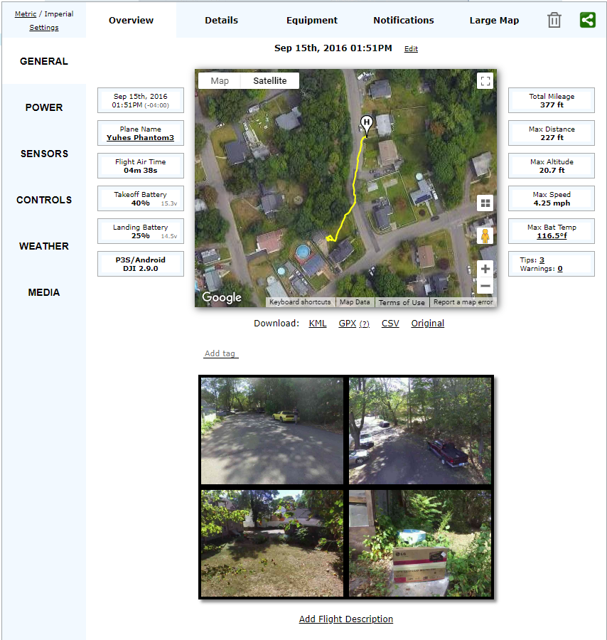
Airdata Information Extraction
Distance Traveled
Altitude
Battery / Power Levels
Flight Time
Drone Type
Sensor Values
Weather
Images
Controls

Slide 51
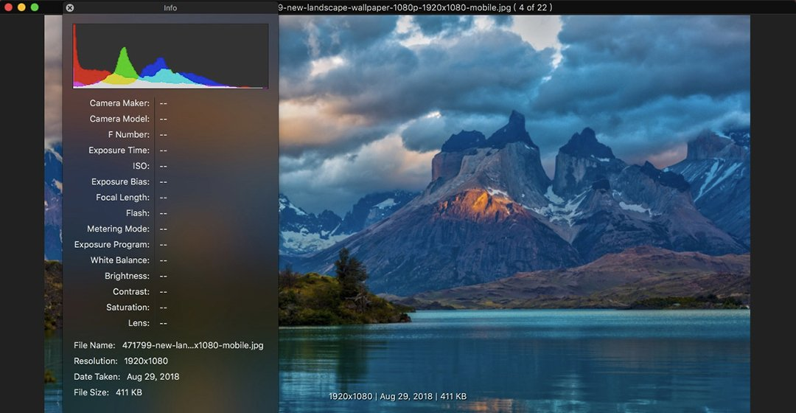
What is EXIF?
EXIF stands for Exchangeable Image File Format
Contains information / metadata about photos
EXIF Tools help us extract the metadata from photos

Slide 52
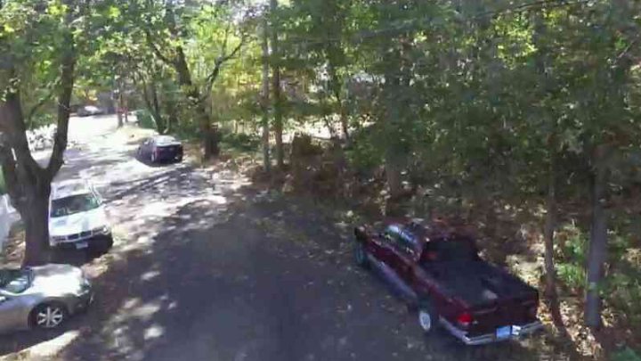
Step 2: Analyze Images using EXIF
Download one of the photos under the Media tab in Airdata
Go to Online EXIF Tool:
https://exif.tools/
Upload photo and click Upload File

Slide 53

EXIF Information Extraction

Slide 54

Step 3: View CSV Flight Sensor Values
CSV stands for Comma Separated Values
Contains data about drone telemetry with timestamps
Steps:
Locate the dji_csv.csv file inside lab-3-forensics folder
Open it in a program or IDE of your choice

Slide 55

Final Case Report
During the investigation, we were able to extract the following information for the case report:
Distance Traveled
Altitude
Battery / Power Levels
Flight Time
Drone Type
Sensor Values
Weather
Images
Controls
Camera Type
GPS coordinates
Time stamps
And more!

Slide 56



Class Overview
Drone Overview and Vulnerabilities
Reconnaissance and Exploitation
Attacks and Countermeasures
Overview, Hardware, Comm Links, and Attack Phases
Radio, Wi-Fi, Packet Analysis, and Port Scanning
Attack Surface, Vulnerability Types, and Investigation

Slide 57

Tips to Keep your Drone Safe!
Use secure encryption protocols for drone and controller communication
Strong credentials on drone applications
Regularly check for software updates on ground station and device
Avoid public Wi-Fi networks when operating drone
Store your drone in secure locations to avoid tampering
Be cognizant of manufacturer guidelines
Keep Track of Flight Logs
Check privacy settings on drone applications

Slide 58




Resources for Further Exploration
Dark Wolf Drone Playbook: Comprehensive guide to UAS hacking DroneSploit: Drone exploitation framework for Wi-Fi based drones
DroneXtract: Drone Digital Forensics Suite

Slide 59


Thank you!
Please feel free to reach out with any questions and/or feedback!
angelinatsuboi@proton.me
angelinatsuboi.com

